Slide 1
Learning Management System
Democratic Team Organization
Jacob Rodriguez Tosun Pahsa Ahmet Duran Triet

Slide 2
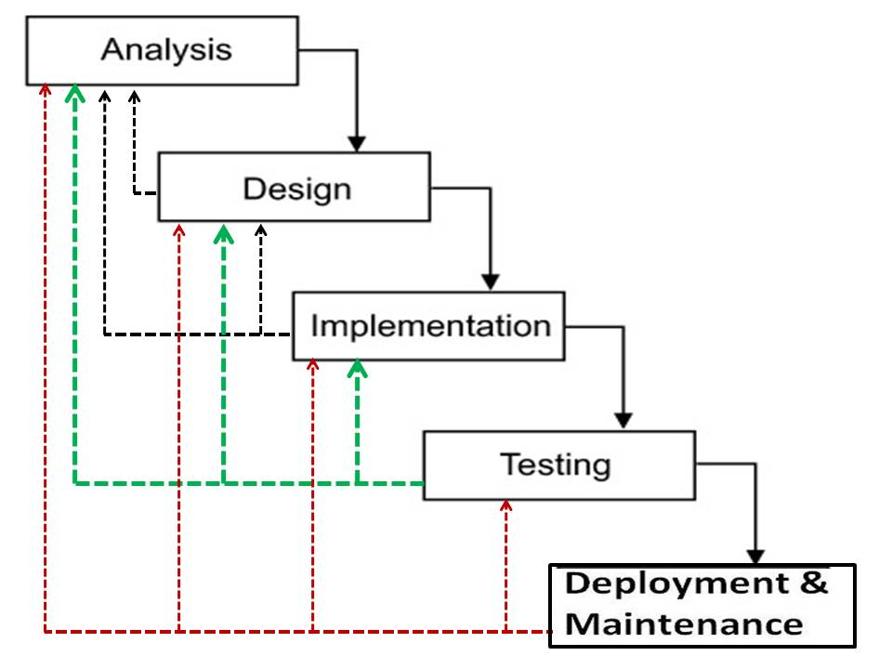
Waterfall Life cycle

Slide 3
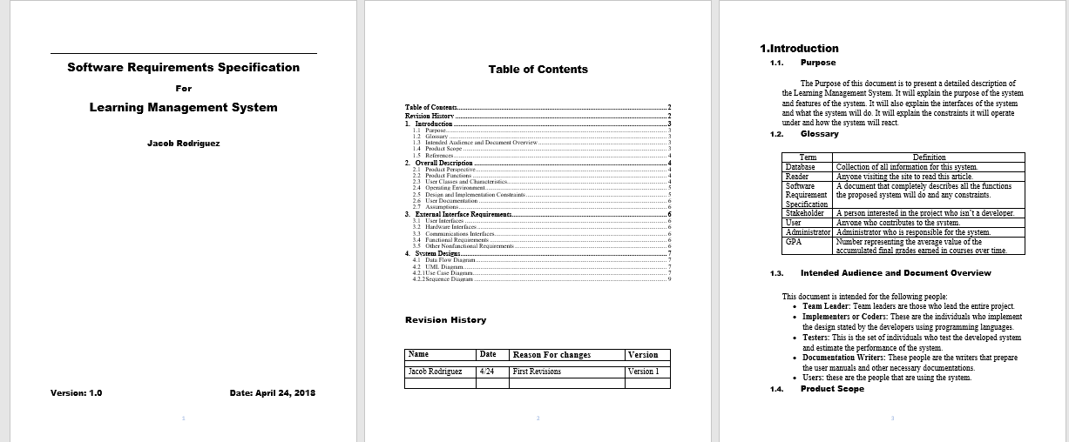
Software Requirement Specification

Slide 4
Software Requirement Specification
Product Perspective:
This system will be familiar to Blackboard or Moodle, which are typical learning management systems. Generally speaking, learning management system deals with all kinds of student details, academic related reports, college details, course details, curriculum, batch details and other resource related details too. There are many similar programs that offer similar settings but every school is different, which has different highlights for their students.
Product Functions
The learning management system is a system that supports learning process of teaching and learning in the school. Student can view their courses, exam grades, and their GPA. Administrator can manage the system from a dashboard.

Slide 5
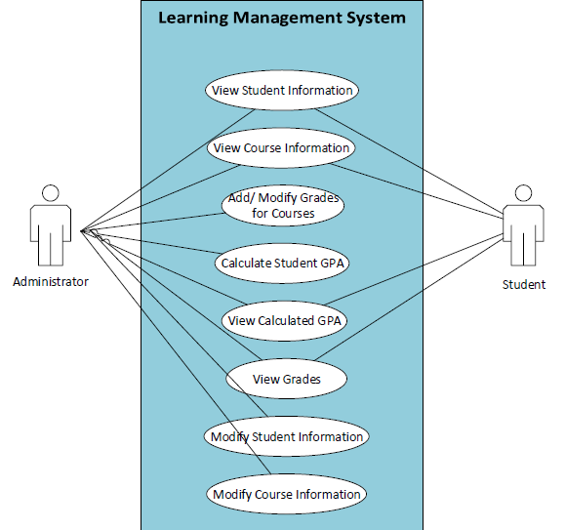
UML Use Case Diagram

Slide 6
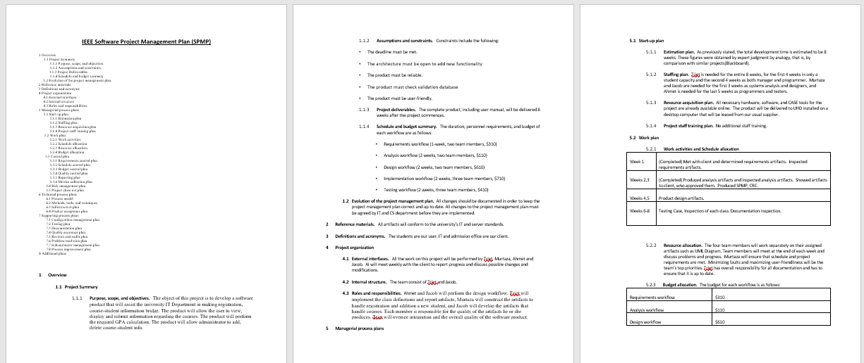
Software Project Management Plan

Slide 7
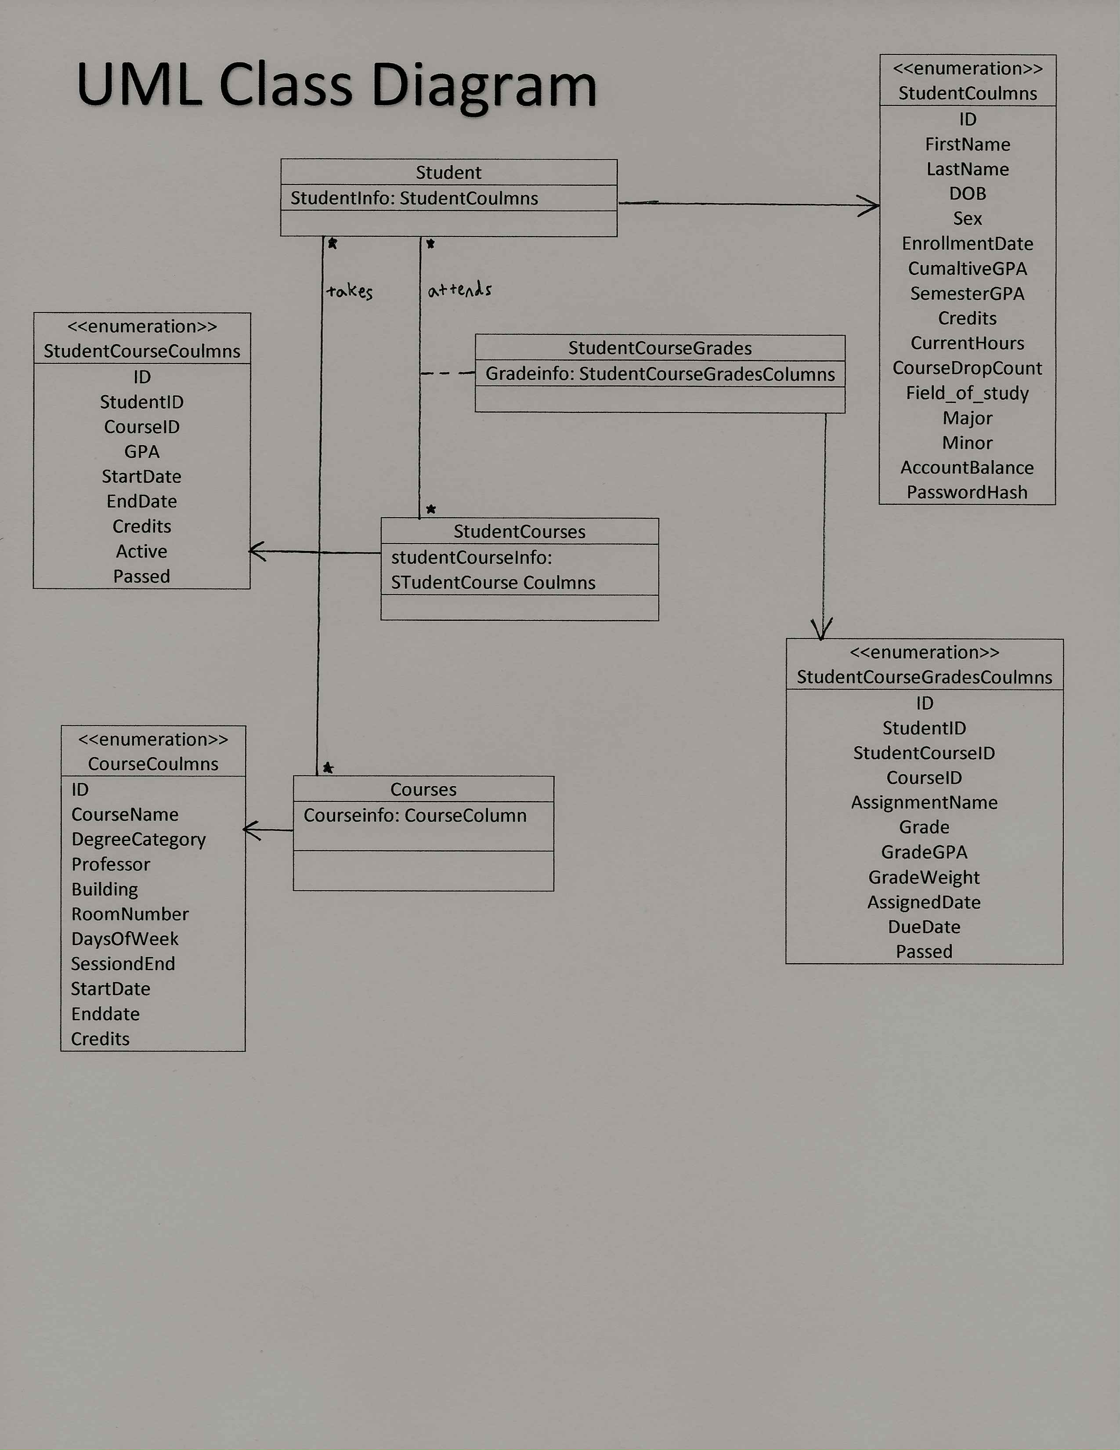
UML Class Diagram

Slide 8
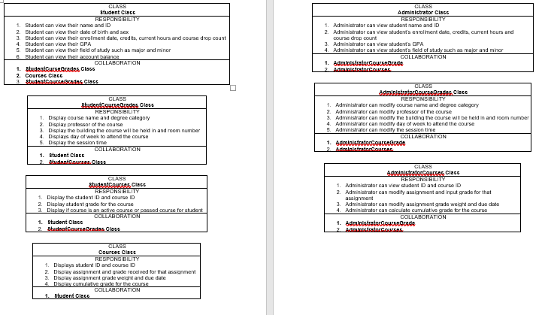
Class-Responsibilty-Collaboration Cards

Slide 9
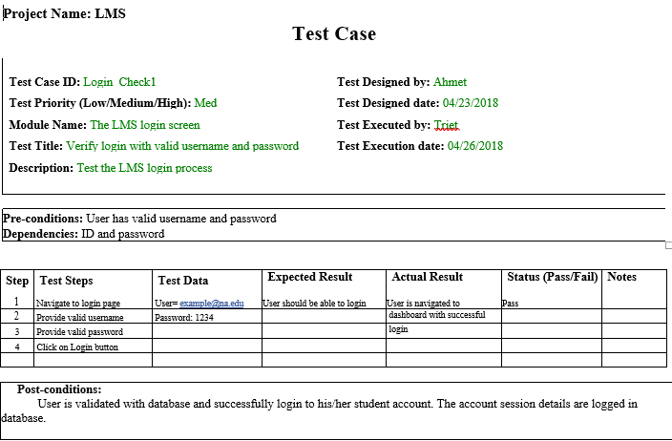
Example of One of Our Test Case

Slide 10
Demo

